Slide 1


DEPARTMENT OF ELECTRONICS AND COMMUNICATION ENGINEERING MINOR PROJECT 1 FINAL REVIEW SOLAR WIRELESS ELECTRIC VEHICLE WITH OBSTACLE DETECTOR
GUIDED BY:
Dr.R.RAJESH KANNA
PRESENTED BY:
NITHISHKUMAR C [927621BEC140]

Slide 2

LIST OF CONTENT
ABSTRACT
EXISTING METHOD
NEW METHOD
COMPONENTS
REFERENCE

Slide 3
ABSTRACT
Electric vehicles (EV) have exhibited effectiveness in minimizing travel costs by substituting electricity for fuel, which is significantly less expensive, in addition to environmental advantages. Here, we develop an EV charging system that provides a unique and innovative solution. The charging of EV is carried out wirelessly; there is no need to stop in order to charge; the charging system is powered by solar energy; and no external power source is required. In order to construct the EV system, the following components are used: a solar panel, battery, transformer, regulator circuitry, copper coils, an AC-DC converter, an ATmega 328p controller, and an LCD display. The method shows how electric cars may be charged while driving, doing away with the requirement to pull over for recharging. As a result, the technology shows how an on-road solar-powered wireless charging system for electric vehicles can be implemented and also self detect the Infront vehicles using ultrasonic sensor . Also control car using Bluetooth module
Keywords: Electric Vehicle, Solar energy, ultrasonic sensor, Bluetooth module.

Slide 4

LITERATURE SURVEY
EV is viewed as a load during charging and as a source during discharging. In this study, EV is represented by the battery and charger components
The charging is set the power factor unit, and the driving mode is used to drive the motor. Even though it is highly flexible for the implementation, it is less in cost and volume than the previous EV
Energy storage limits the charging infrastructure and runs costs by serving electric vehicles during the system’s uttermost load intervals . Energy storage can also improve electric vehicles’ stability by supplying necessary and sufficient energy to reach

Slide 5
EXISTING METHOD
The concept that has so far gained the most traction uses alternating magnetic fields generated using existing electric currents along a road.
The main problem with this method is that magnetic fields are unwieldy and they must be controlled to stop them from harming passengers or heating up reinforcement bars on the road.
Meanwhile, Ferrite, the material used to guide fields, is brittle, expensive, and loses a lot of energy when magnetic fields are changing quickly.

Slide 6
NEW METHOD
Our team researchers designed a system that utilizes pairs of insulated metal plates that are placed on the ground.
These are connected to a power line through a matching network and a high-frequency inverter.
These plates create oscillating electric fields that attract and repel charges in metal plates attached to the underside of the moving vehicles.
A high-frequency current is then driven, and rectified, through a circuit on the vehicle, where it charges the vehicle's battery.
Their system does not require materials such as ferrite and it can operate at much higher frequencies.
we add obstacle detector with Bluetooth module

Slide 7
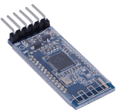

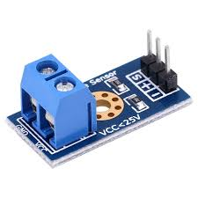
COMPONENTS REQUIRED
Battery
ultrasonic Sensor
Vehicle Body Wheels Switches
Resistors, Capacitors
Transistors Cables and Connectors
Arduino
Bluetooth module
Servo

Slide 8
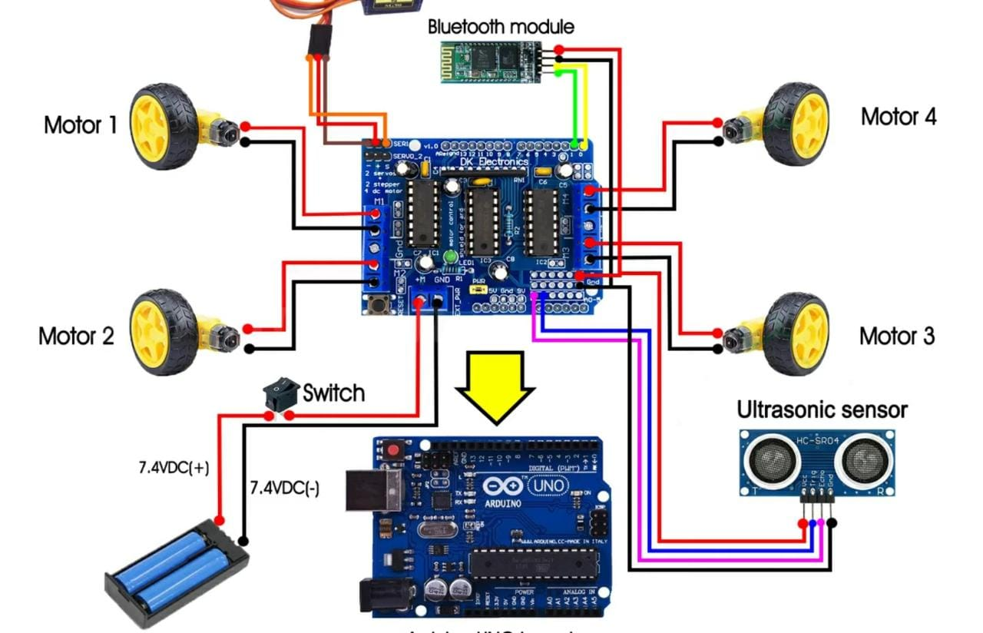
CIRCUIT

Slide 9
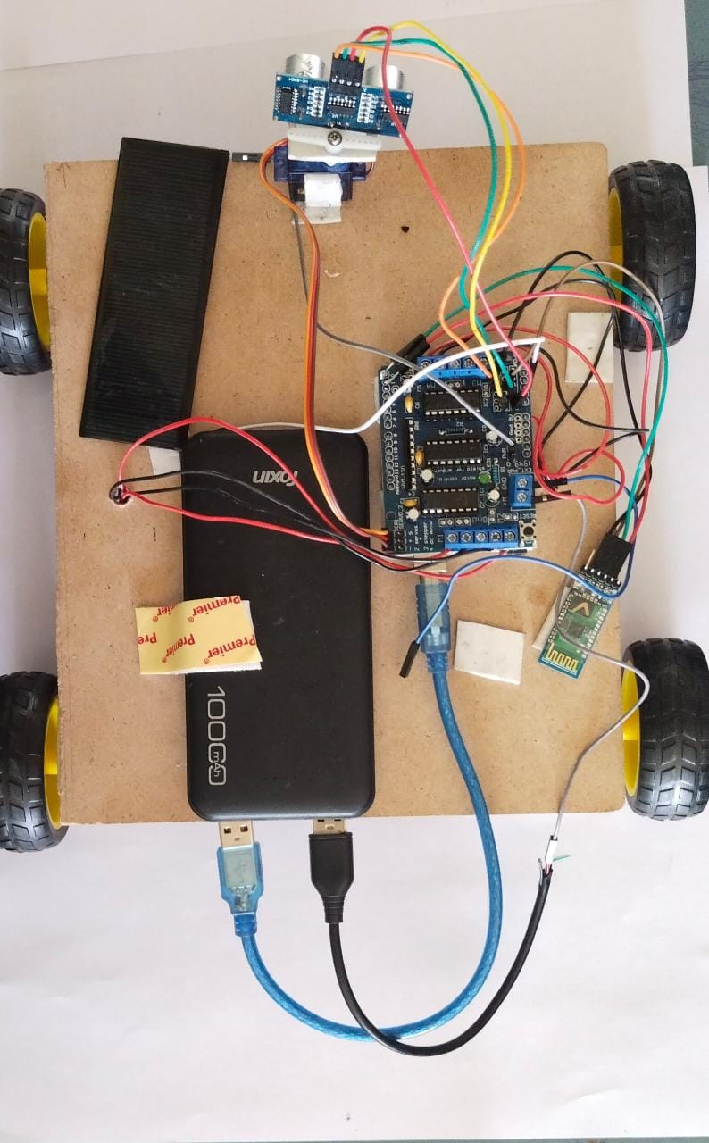

Slide 10
REFERENCE
[1] Kang Miao, Bidirectional battery charger for electric vehicles, Asia (ISGT Asia) 2018.
[2] Pinto, J. G. Bidirectional battery charger with Grid-to-vehicle, Vehicle -to-Grid and Vehicle-to- Home technologies, IEEE 2020.
[3] Bugatha Ram Vara prasad, “Solar Powered BLDC Motor with HCC Fed Water Pumping System for Irrigation,” Int. J. Res. Appl. Sci. Eng. Technol., vol. 7, no. 3, pp. 788–796, 2019, doi: 10.22214/ijraset.2019.3137.
[4] Gallardo-Lozano, Milanes-Monster, Guerrero- Martinez, Three-phase bidirectional battery charger for smart electric vehicles, International Conference-Workshop 2021. M. C. Kisacikoglu, “Vehicle-to-grid (V2G) reactive power operation analysis of the EV/PHEV bidirectional battery charger,” Ph.D. dissertation, University of Tennessee, Knoxville, 2019.

Slide 11
THANK YOU

